Slide 1

SOFTWARE COMPONENT CATALOGING SOFTWARE
Group 9 :-
Rounak Raj (20JE0815)​
Sahil Khare (20JE0828)
Sameer Kumar (20JE0847)
Sameer Pandey (20JE0848)

Slide 2

PROBLEM STATEMENT
The software component cataloguing software consists of a software components catalogue and various functions defined on this components catalogue. The software components catalogue should hold details of the components which are potentially reusable. The reusable components can be either design or code. The design might have been constructed using different design notations such as UML , ERD , structured design, etc. Similarly, the code might have been written using different programming languages. A cataloguer may enter components in the catalogue, may delete components from the catalogue, and may associate reuse information with a catalogue component in the form of a set of key words. A user of the catalogue may query about the availability of a component using certain key words to describe the component. In order to help manage the component catalogue (i.e., periodically purge the unused components) the cataloguing software should maintain information such as how many times a component has been used, and how many times the component has come up in a query but not used. Since the number of components usually tend to be very high, it is desirable to be able to classify the different types of components hierarchically. A user should be able to browse the components in each category.

Slide 3

Functionalities
Login/sign-up
search
sorting
New and existing users need to signup and login respectively, to start using the services offered by our SCCS
The users can search various components using the name of the component and the tags assigned by the respective authors
The various components available are sorted on the basis of the upvotes they receive from other users of SCCS, such that everyone gets best results first
statistics
User access
On the back-end of our project, we can get a stat report for all the components present reflecting usage of various components
The users can utilize the components present in various fashions, like simply using them, creating a new one, or updating existing ones

Slide 4

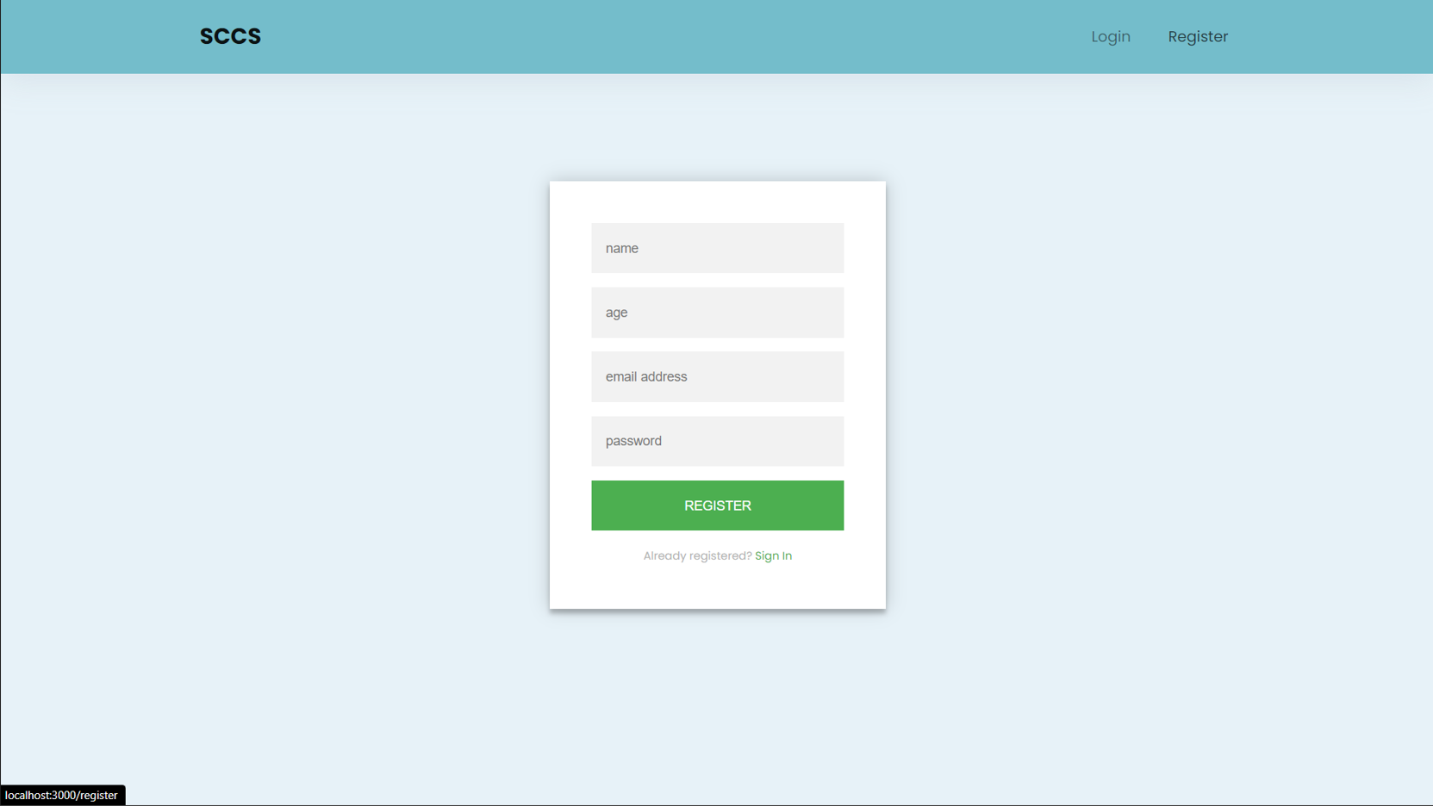
Signup page
The Signup page for new users

Slide 5
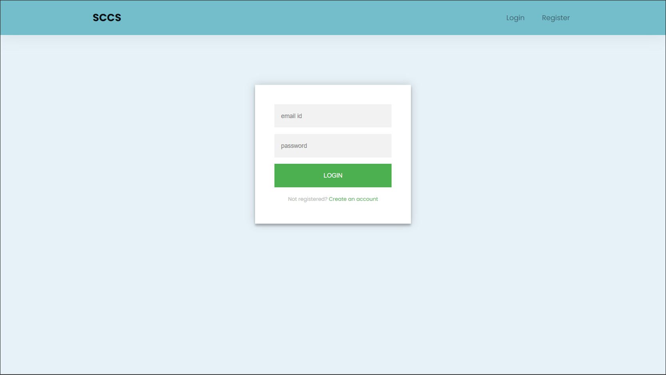
Login page
The Login Page for existing users

Slide 6
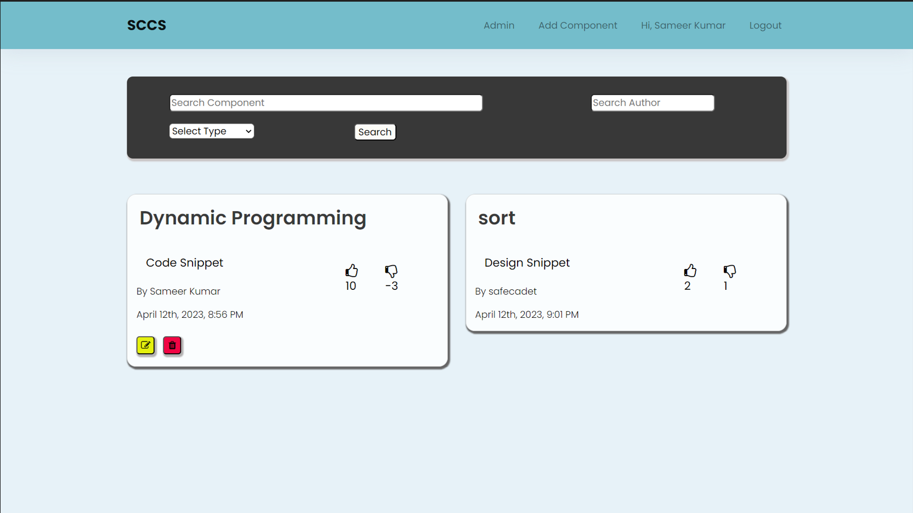
homepage
The homepage that we encounter after authenticating

Slide 7
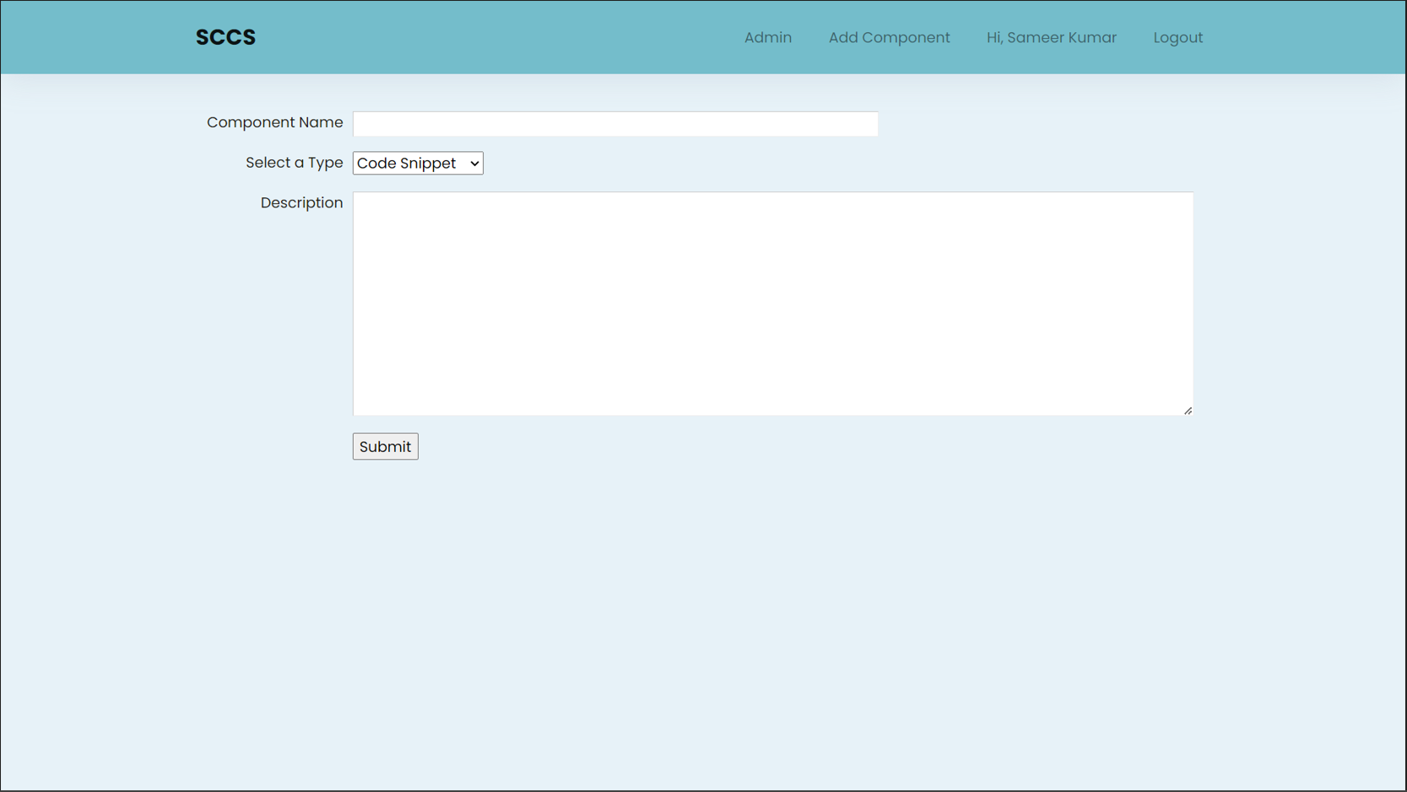
Adding component
This page will facilitate adding a new component

Slide 8
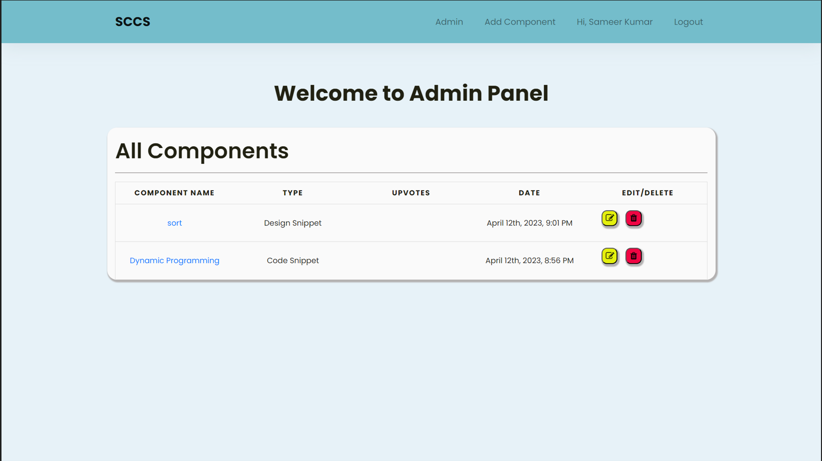
Admin page
The Admin Page where the admin can see the ongoings

Slide 9




“Tech stack”
For front-end
Authentication
For back-end
database
We used the most popular and standard entities of the Front-end world i.e. HTML, CSS, JavaScript, EJS
The well-known Passport JS was incorporated in our Project for authentication purposes
The heavily relied upon Node JS library was used to implement all the backend activities for SCCS
MongoDB which is a NoSQL database was employed to maintain all the database operations

Slide 10
Future endeavors
Comment section
Intros
Community creation
A very good and important addition to our SCCS project would be to have comment sections corresponding to every component. This will allow users to have discussions among themselves and others, thus improving overall experience
Another addition can be allowing creators of components to add a short description in video/textual format to describe the functionality of the component in question, thus helping others
Future iterations of SCCS can have options for users to follow authors with good and helpful contributions, thus informing other users to easily find credible sources of information

Slide 11
Tasks done!
Rounak Raj
Sahil Khare
Primarily focused on the Front-end part of the Project
Collaboratively helped in implementing the Database of our Project
Focused on the Front-end part of the Project
Implemented the sorting by upvotes functionality
Sameer Kumar
Sameer Pandey
Created the authentication system pertaining to our project
Implemented Search by name of component and tag functionality
Collaboratively helped in implementing the Database of our Project
Implemented the Statistical Report of every component functionality

Slide 12

Project benefits
Supports CRUD operations on Components
A quick search for the required Component
Effective use of Database​
Multi-lateral scope of improvements

Slide 13

Thank you!

